Slide 1


INTRO TO
Valentina Erastova
Tonia Mey
Claire Hobday
Salome Llabres, Mario Antonioletti, David McKain, Jenke Scheen, Sofia Bariami

Slide 2
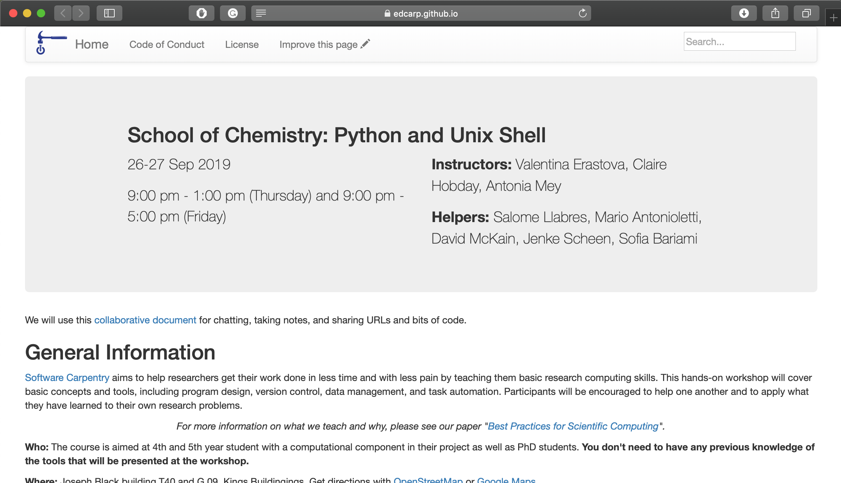
https://edcarp.github.io/2019-09-26-edinburgh-swc/

Slide 3
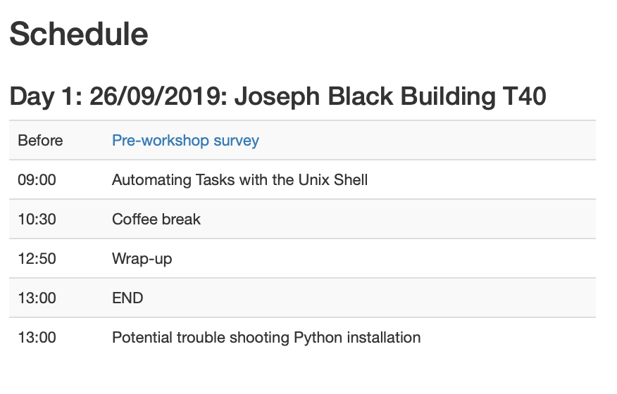
SYLLABUS
Files and Directories
History and Tab Completion
Pipes and Redirection
Looping Over Files
Creating and Running Shell Scripts
Finding Things

Slide 4
SHELL - 🤔?
WHAT?
Command line interface between YOU and UNIX (& its friends)
WHY?
Introduce some fundamental ideas of using computers
repetitive tasks be gone!
Things depend on it – supercomputers, installing programs, …
Gives you access to tools/resources 😃

Slide 5
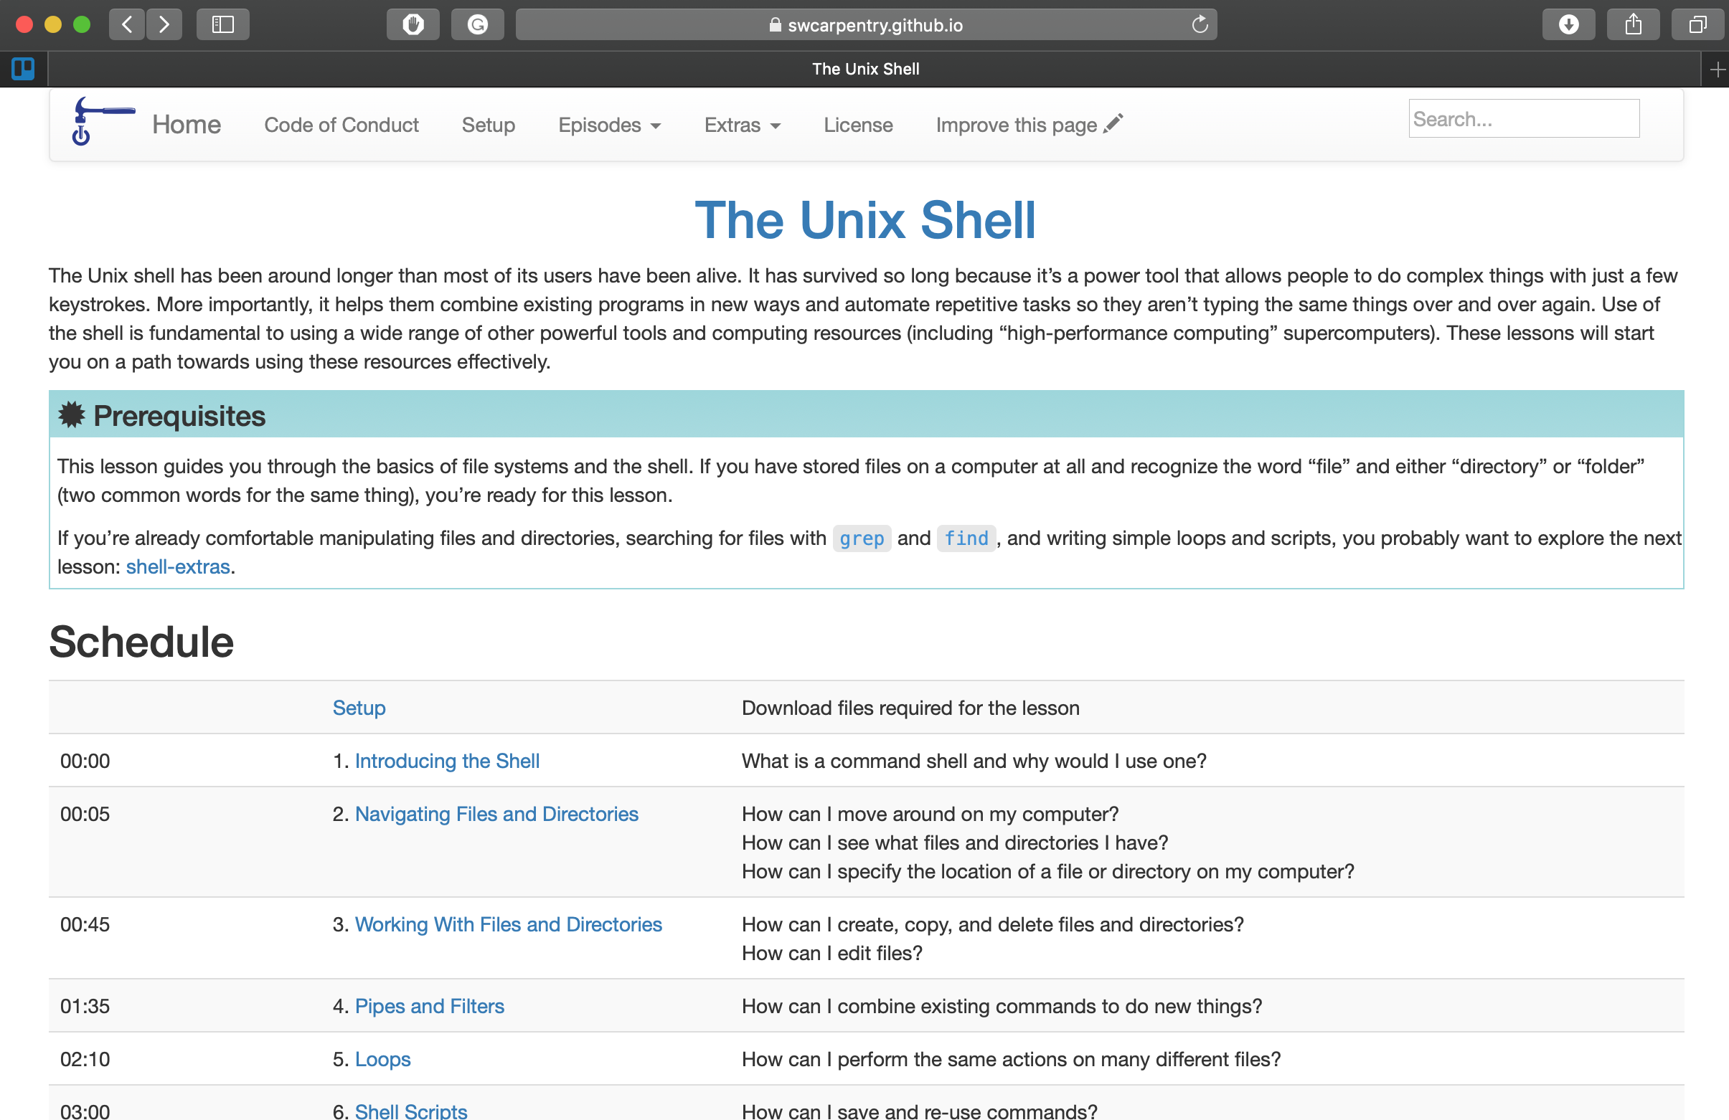
https://swcarpentry.github.io/shell-novice/
swcarpentry.github.io/shell-novice/
Notes:
OPEN TERMINAL TOGETHER AND EXPLAIN $ … bash …

Slide 6
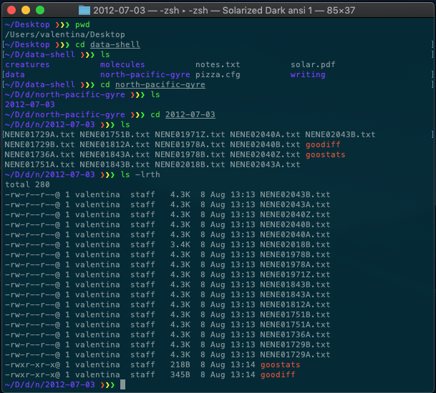
Notes:
Through series of exercises we will help Nelle write her THESIS about Great Pacific Garbage Patch

Slide 7
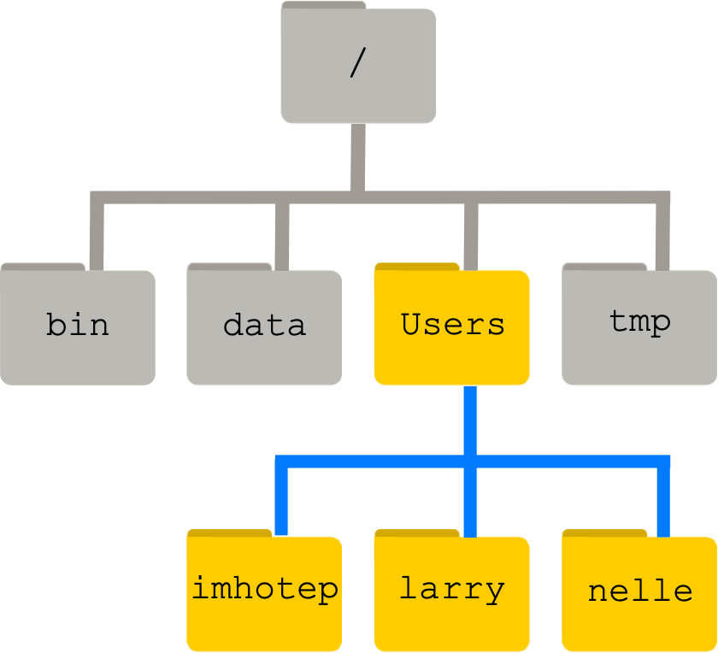
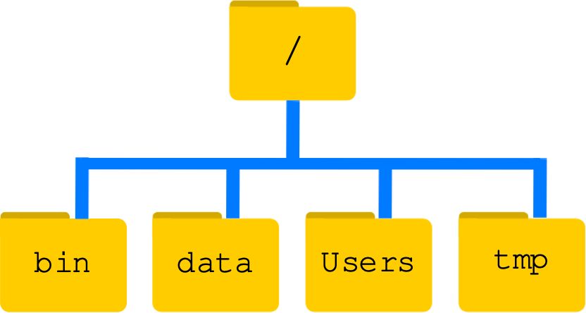
nelle’s computer
👩🏼‍🦰
nelle
$ pwd
nelle’s
folder
/Users/nelle
Notes:
START WORK TAB

Slide 8
How to Name files and directories?
no spaces 😖 north pacific gyre
😊 north-pacific-gyre
no strange symbols 😖 Peter & Mary
😊 Peter_Mary
with extensions 😖 mydocument
😊 mydocument.txt

Slide 9
Removing on Linux is for REAL!
$ rm text.txt
will remove the file completely (no Bin/Trash/..)
$ rm –i text.txt
rm: remove regular file ‘text.txt’?
will prompt you to confirm by typing y
or cancel by typing n

Slide 10
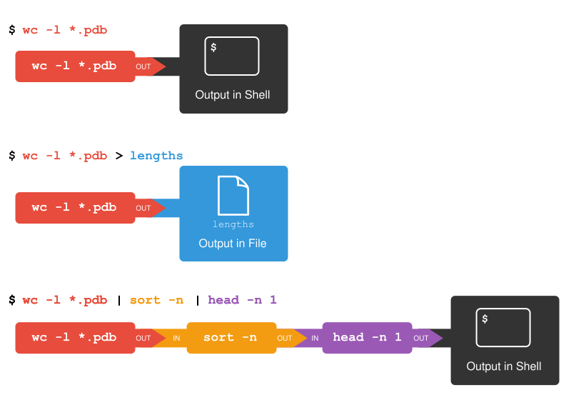
Pipe lines with Filters

Slide 11
Loops
START
Save it for later!
new input?
no
do-it.sh
for filename in *.dat
yes
do something…
do
echo $filename
head –n 100 $filename | tail –n 20
done
END

Slide 12

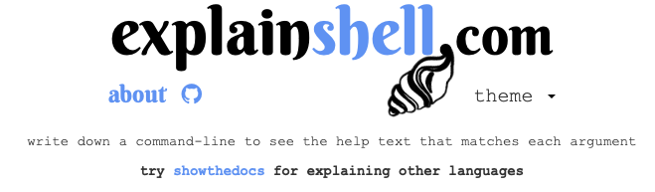
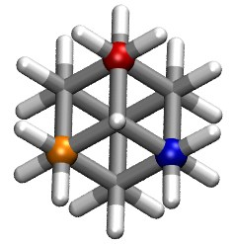
more...
Tomorrow, 27th September, 9am – 5pm
G.09 in Murchison House, KB
intro to
Edinburgh Carpentries
edcarp.github.io
erastova.xyz

